Slide 1

ROCKBUSTER STEALTH LLC Data Analysis Project
By:
Asawer Maknoon
June-2024

Slide 2

PROJECT OVERVIEW
What is Rockbuster Stealth LLC is a fictional global movie rental company facing competition from streaming giants like Netflix and Amazon Prime. To stay competitive, they plan to launch an online video rental service using their extensive movie license portfolio.
Objective: this project will use data analytics to address key business questions, informing Rockbuster’s 2020 strategy as they shift to an online service model. These insights will guide decision-making and strategic planning.

Slide 3










KEY QUESTIONS
Which movies contributed the most/least to revenue gain?
Where are customers with a high lifetime value based?
What was the average rental duration for all videos?
Do sales figure vary between geographic regions?
Which countries are Rockbuster customers based in?

Slide 4

DATA OVERVIEW
Films: 1000
Film Genres: 17
Film Runtime: Average 115 min
Average Rating: PG-13
Replacement Cost Average: $20
Average Rental Duration: 5 Days
Average Rental Rate: $2.98
Customers: 599

Slide 5
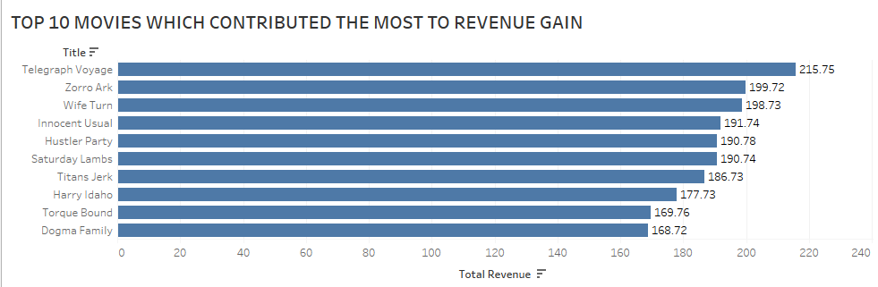
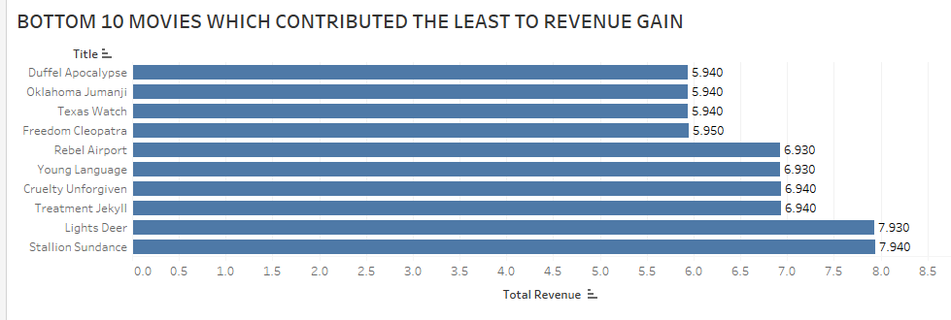

WHICH MOVIES CONTRIBUTED THE MOST/LEAST TO REVENUE GAIN ?
Title | Name | Total Revenue
Telegraph Voyage | Music | 215.75
Zorro Ark | Comedy | 199.72
Wife Turn | Documentary | 198.73
Innocent Usual | Foreign | 191.74
Hustler Party | Comedy | 190.78
Saturday Lambs | Sports | 190.74
Titans Jerk | Sci-Fi | 186.73
Harry Idaho | Drama | 177.73
Torque Bound | Drama | 169.76
Dogma Family | Animation | 168.72

Slide 6
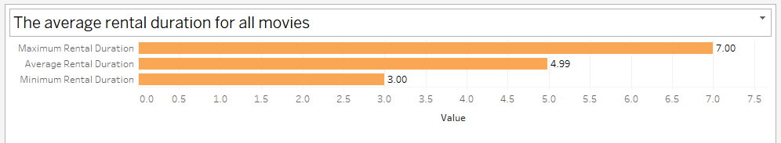
WHAT WAS THE AVERAGE RENTAL DURATION FOR ALL VIDEOS?
The rental durations of the movies are between 3 – 7 days.
The average duration of rental is 5 days.
The most frequent duration of rental was 6 days.

Slide 7
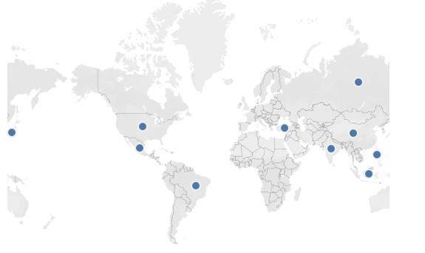
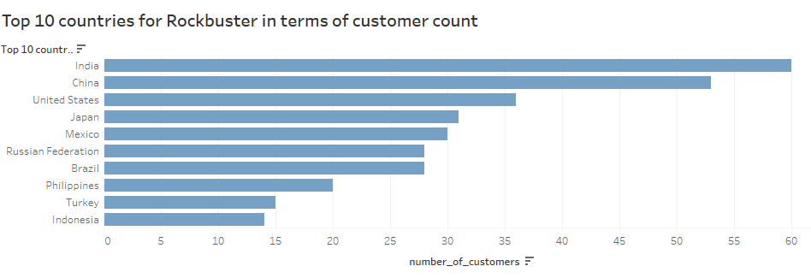
WHICH COUNTRIES ARE ROCKBUSTER CUSTOMERS BASED IN?
Top 5 countries: India
China
United States
Japan
Mexico

Slide 8

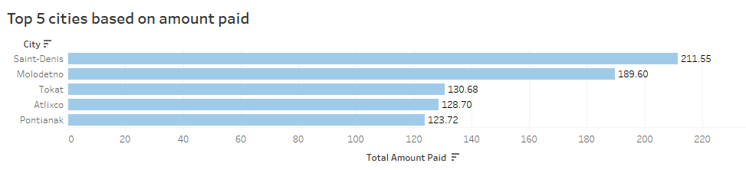
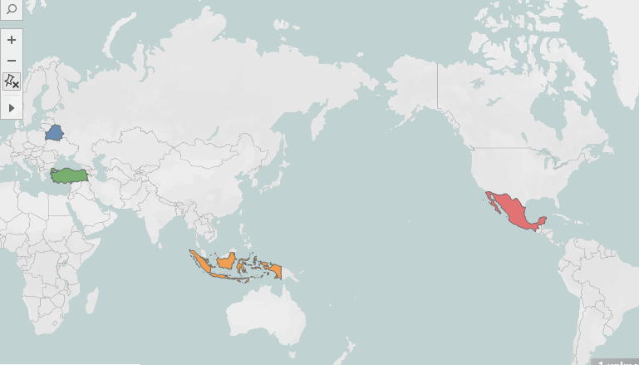
WHERE ARE CUSTOMERS WITH A HIGH LIFTIME VALUE BASED?
City | Total_amount_paid
Saint-Denis | 211.55 $
Molodetno | 189.6 $
Tokat | 130.68 $
Atlixco | 128.7 $
Pontianak | 123.72 $

Slide 9

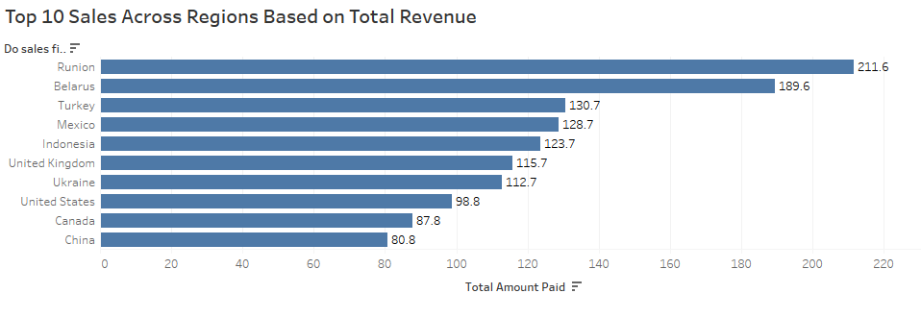
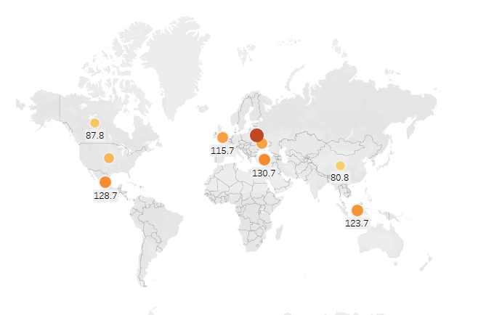
Do sales figures vary between geographic regions?
Top 3 countries with high sales based on revenue gain: Runion
Belarus
Turkey

Slide 10
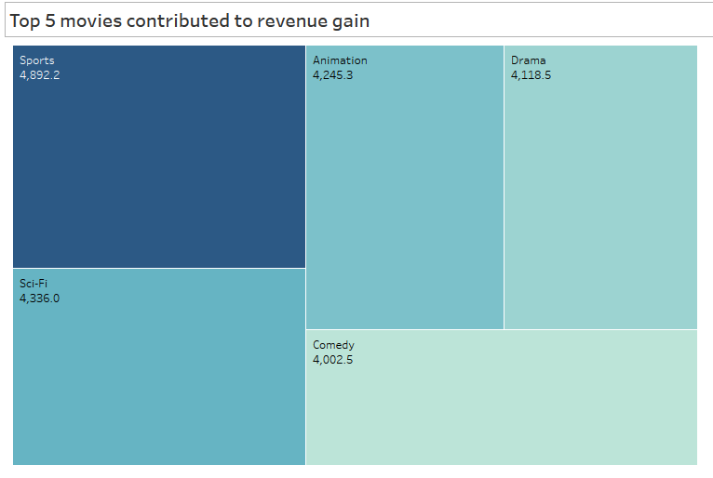

MOST POPULAR GENRES

Slide 11

CONCLUSION
The top 5 genres contributing to revenue gain are sports, sci-fi, animation, drama and comedy.
Top 5 movies contributing to revenue gain are Telegraph Voyage, Zorro Ark, Wife Turn, Innocent Usual, and Hustler Party.
Top 10 countries based on number of customers are India, China, United States, Japan, and Mexico.
Our top 5 cities with highest sales are Saint-Denis, Molodetno, Tokat, Atlixco and Pontianak.
The majority of the high lifetime value customers are from the highest performing countries.

Slide 12

RECOMMENDATION
Beta Launch in Strategic Countries:
Prioritize a beta launch in countries with high customer engagement, such as India, China, the United States, Mexico, and Russia.
This approach allows loyal customers to provide valuable feedback and suggestions, improving the service before a full-scale launch.
Genre-Specific Catalog:
Leverage the popularity of specific film genres (e.g., Sports, Sci-fi, Animation, Drama).
Ensure that the majority of the new online video service’s catalog includes titles from these genres.

Slide 13

Any Questions?
Contact: sawreemak@gmail.com
Tableau link:
ROCKBUSTER STEALTH LLC ?Data Analysis?Project | Tableau Public

